Slide 1

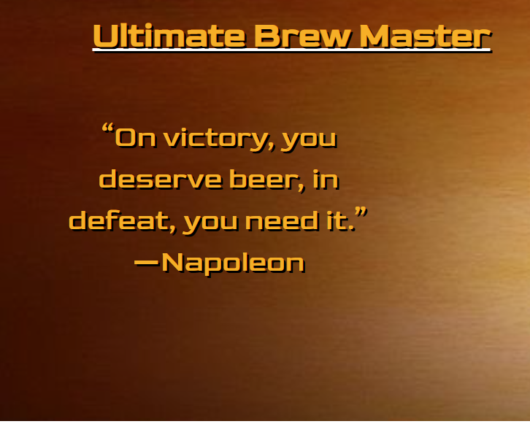
Ultimate Brew Master
Travis Geers
William Bolls
Dean Dunivan
Jake Schlei

Slide 2

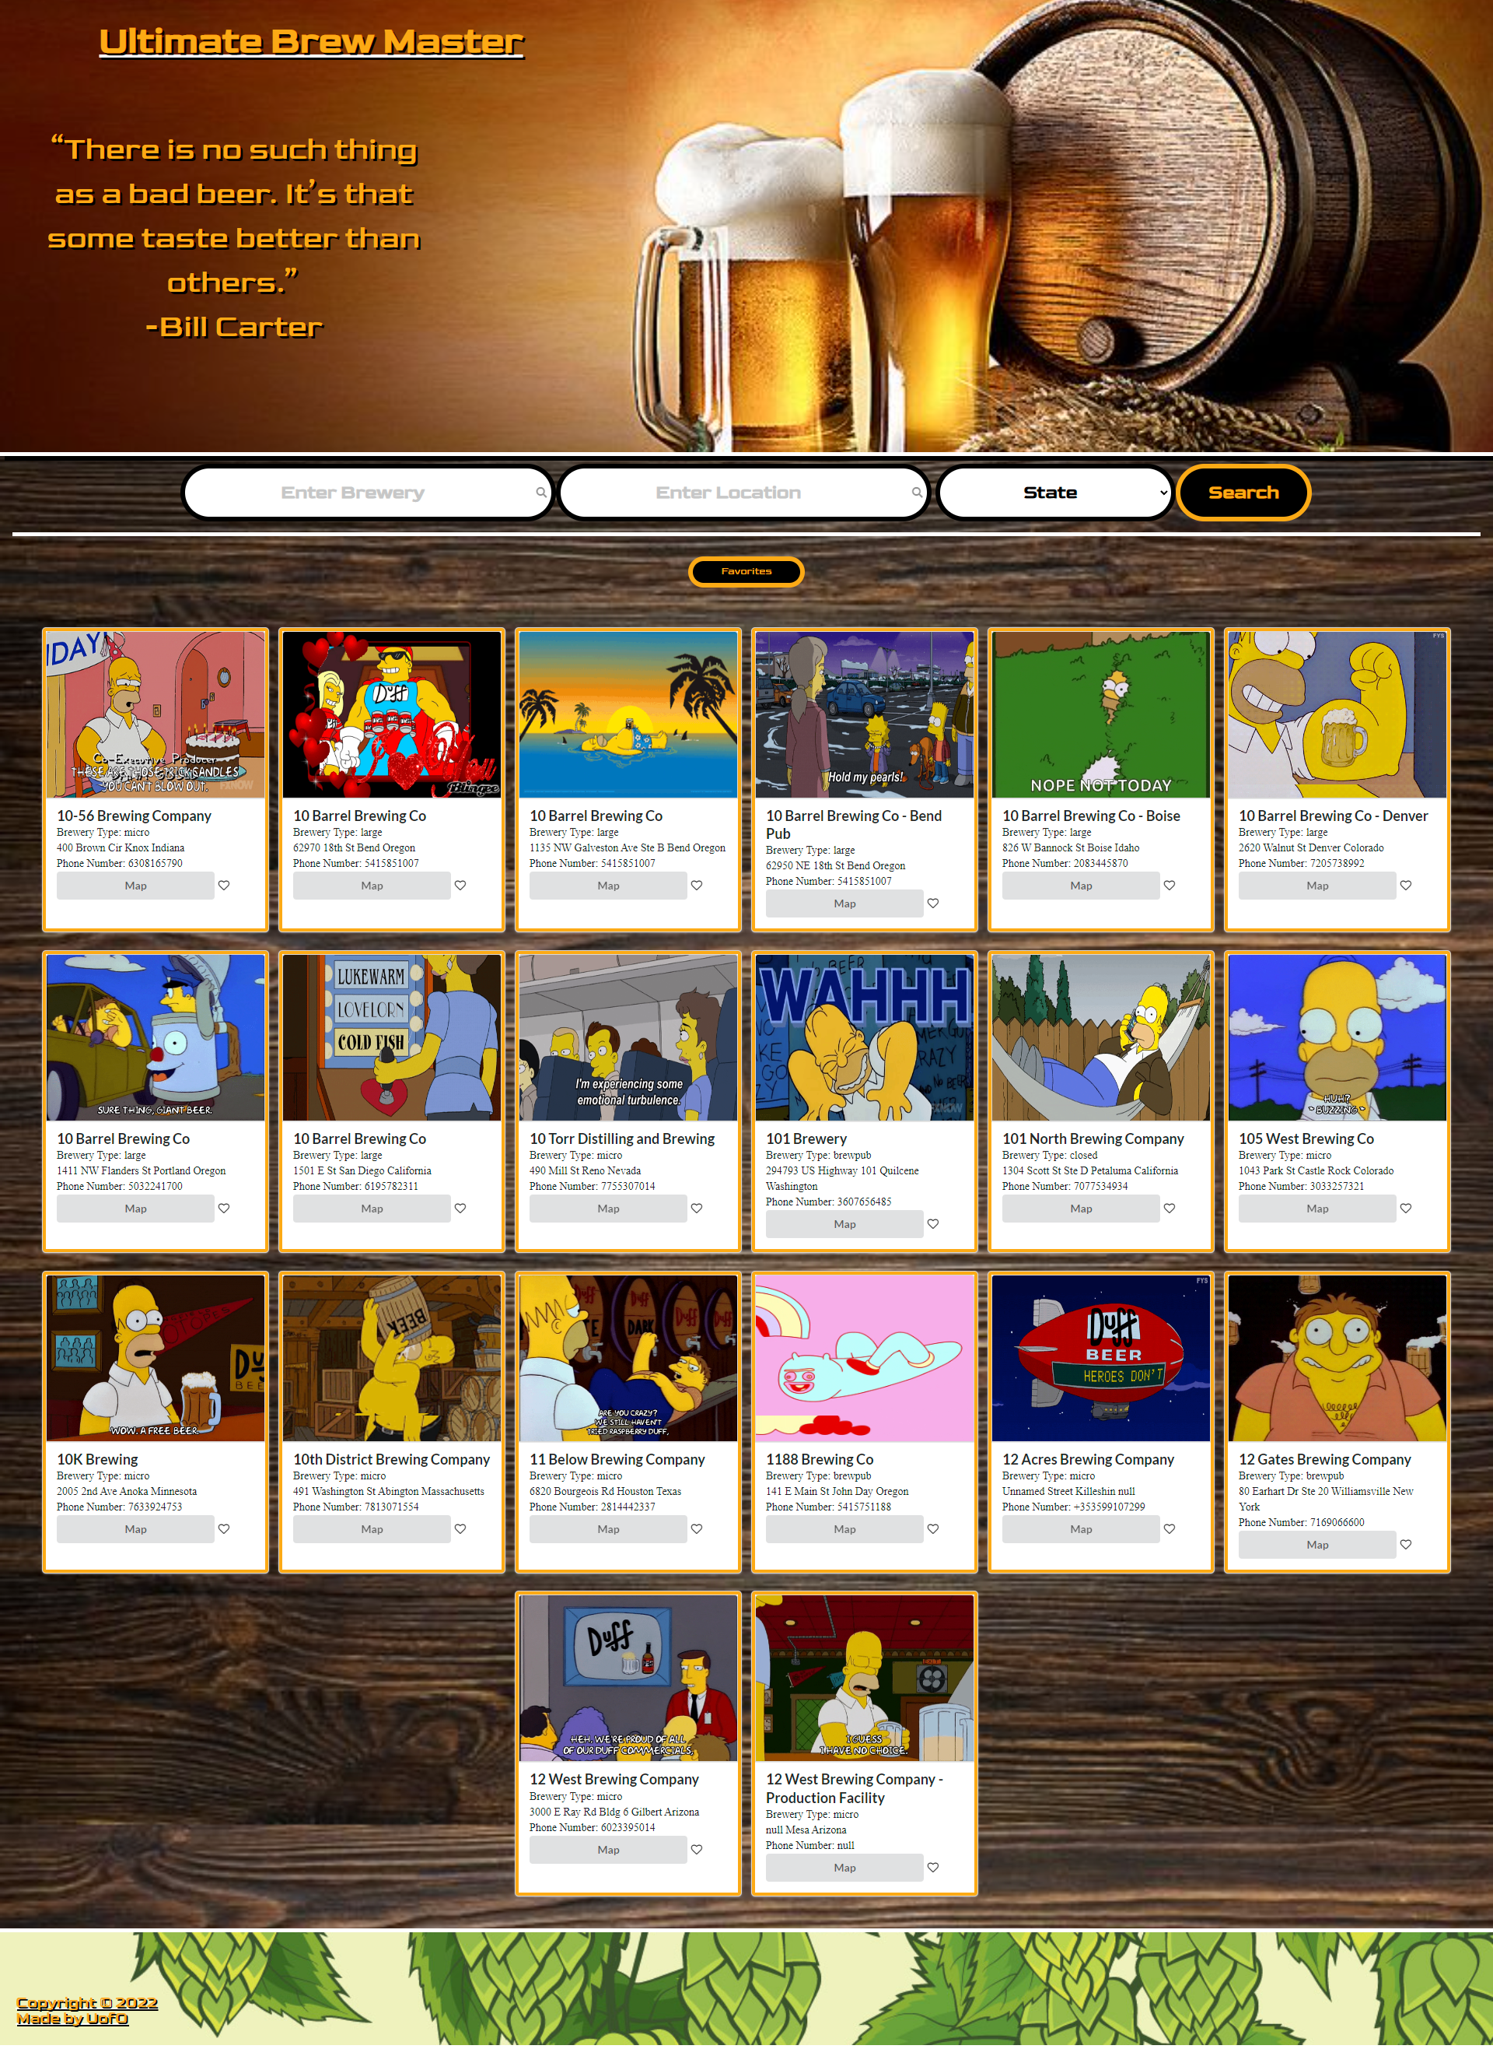
Overview
What and why?

Slide 3
Technologies
Created With:
HTML
CSS
JavaScript
JQuery
Jquery UI
Semantic UI
Open Breweries DB API
Giphy API

Slide 4

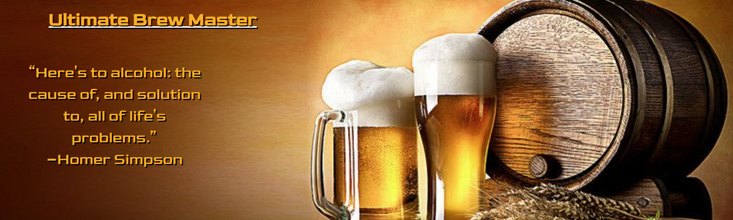
Demo
Let’s show you how it works!

Slide 5
Conflicts
Framework Documentation
Overriding Semantic UI elements
GitHub Merges
APIs, specifically for Maps

Slide 6
Additions
Implement a map API to get directions to breweries, and see where they are in relation to other breweries
Add a review system to leave reviews for other users to see

Slide 7



Cheers!
What questions do you have for us?

